Slide 1
F
O
M
O

Slide 2
WELCOME TO FOMO
The Revolutionary Bar/Night Club Payment Experience
Kingsley Chu – Christopher Jones – Alistair Duff
David Garven – Rastislav Kovac – Roman Sokolovski

Slide 3

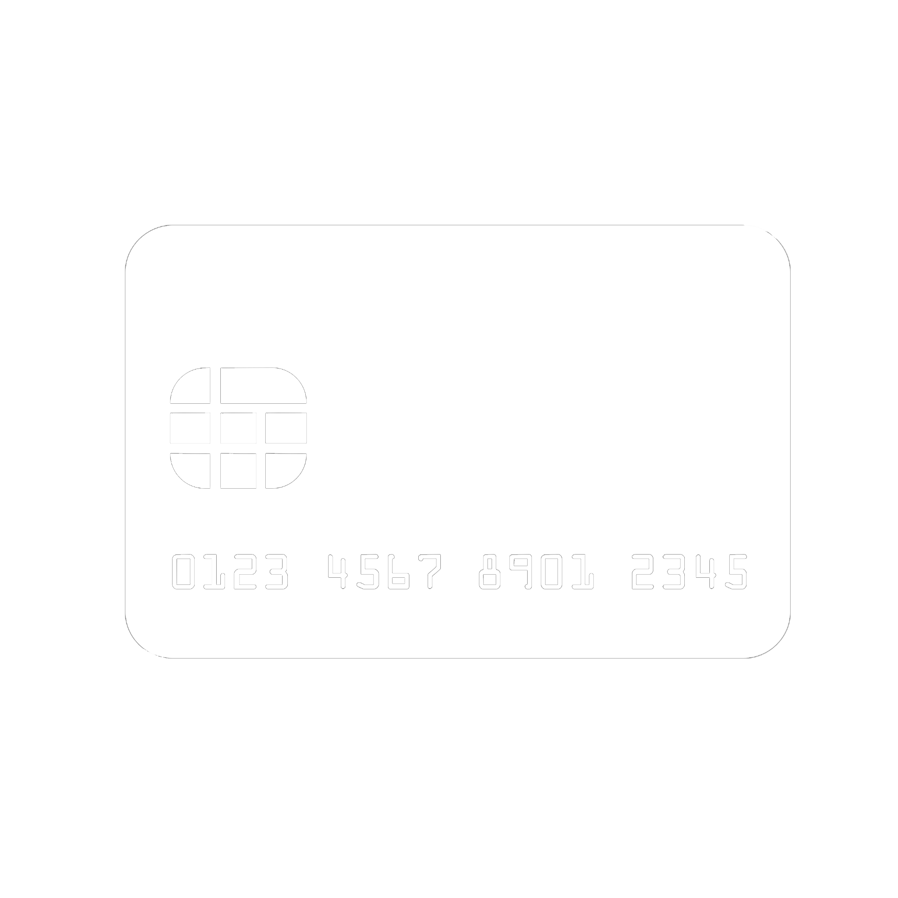

The Problem

Slide 4

Our Solution
FOMO

Slide 5
FOMO
SEAMLESS PAYMENTS AT THE BAR/CLUB
NO CASH OR CARD
SLOWER WAIT TIMES
SET LIMITS
TRACK PURCHASES
LOCATE BARS AROUND YOU

Slide 6
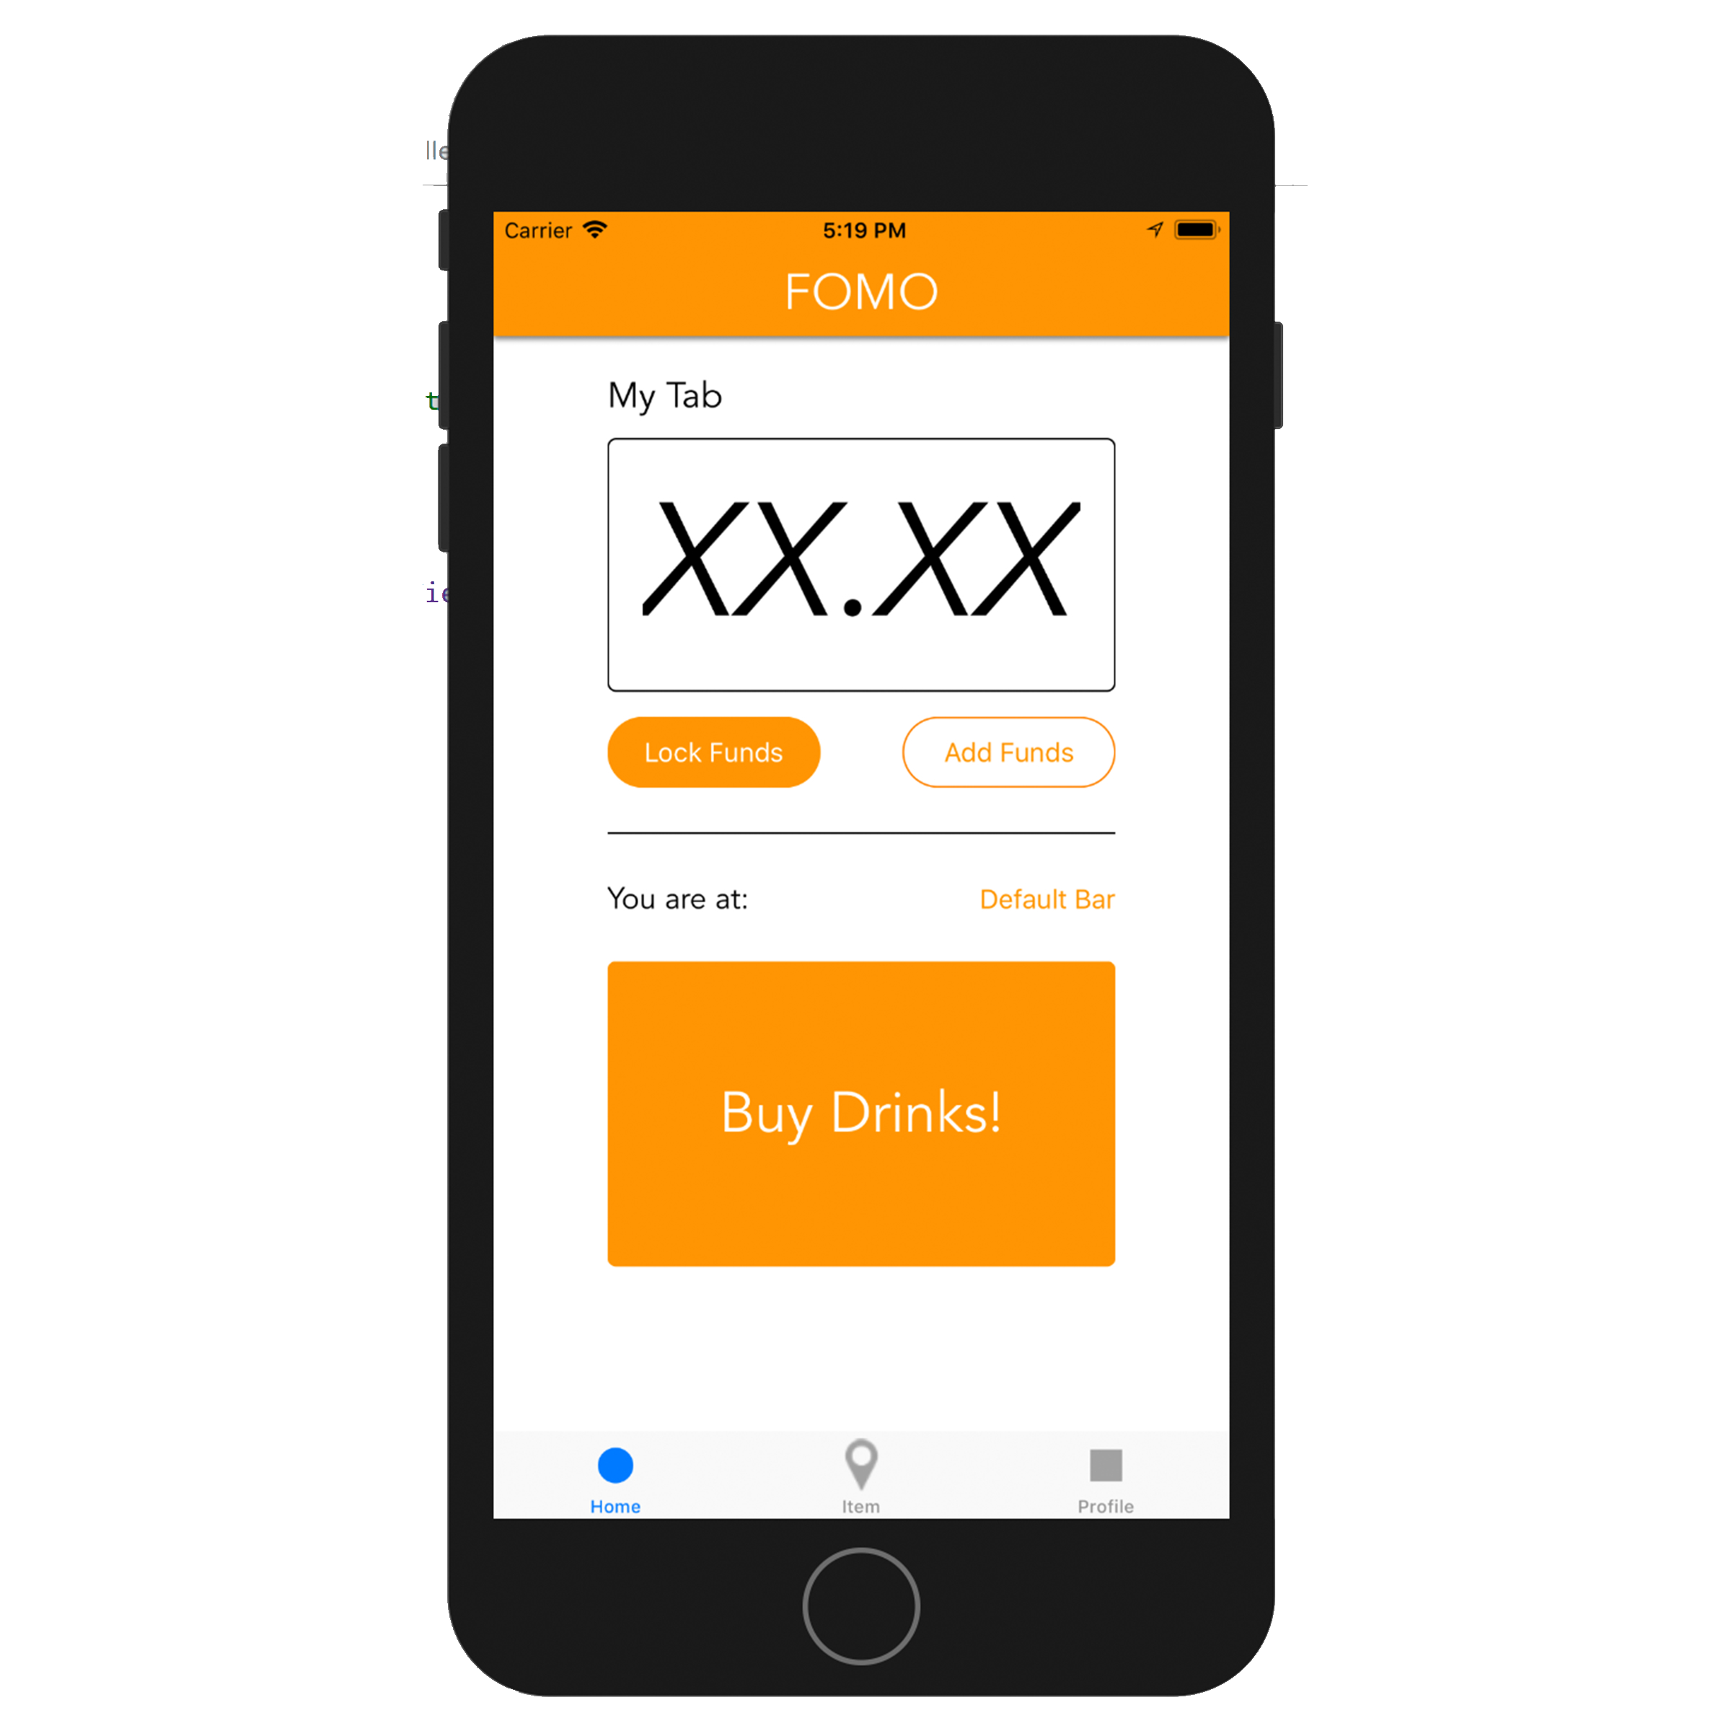
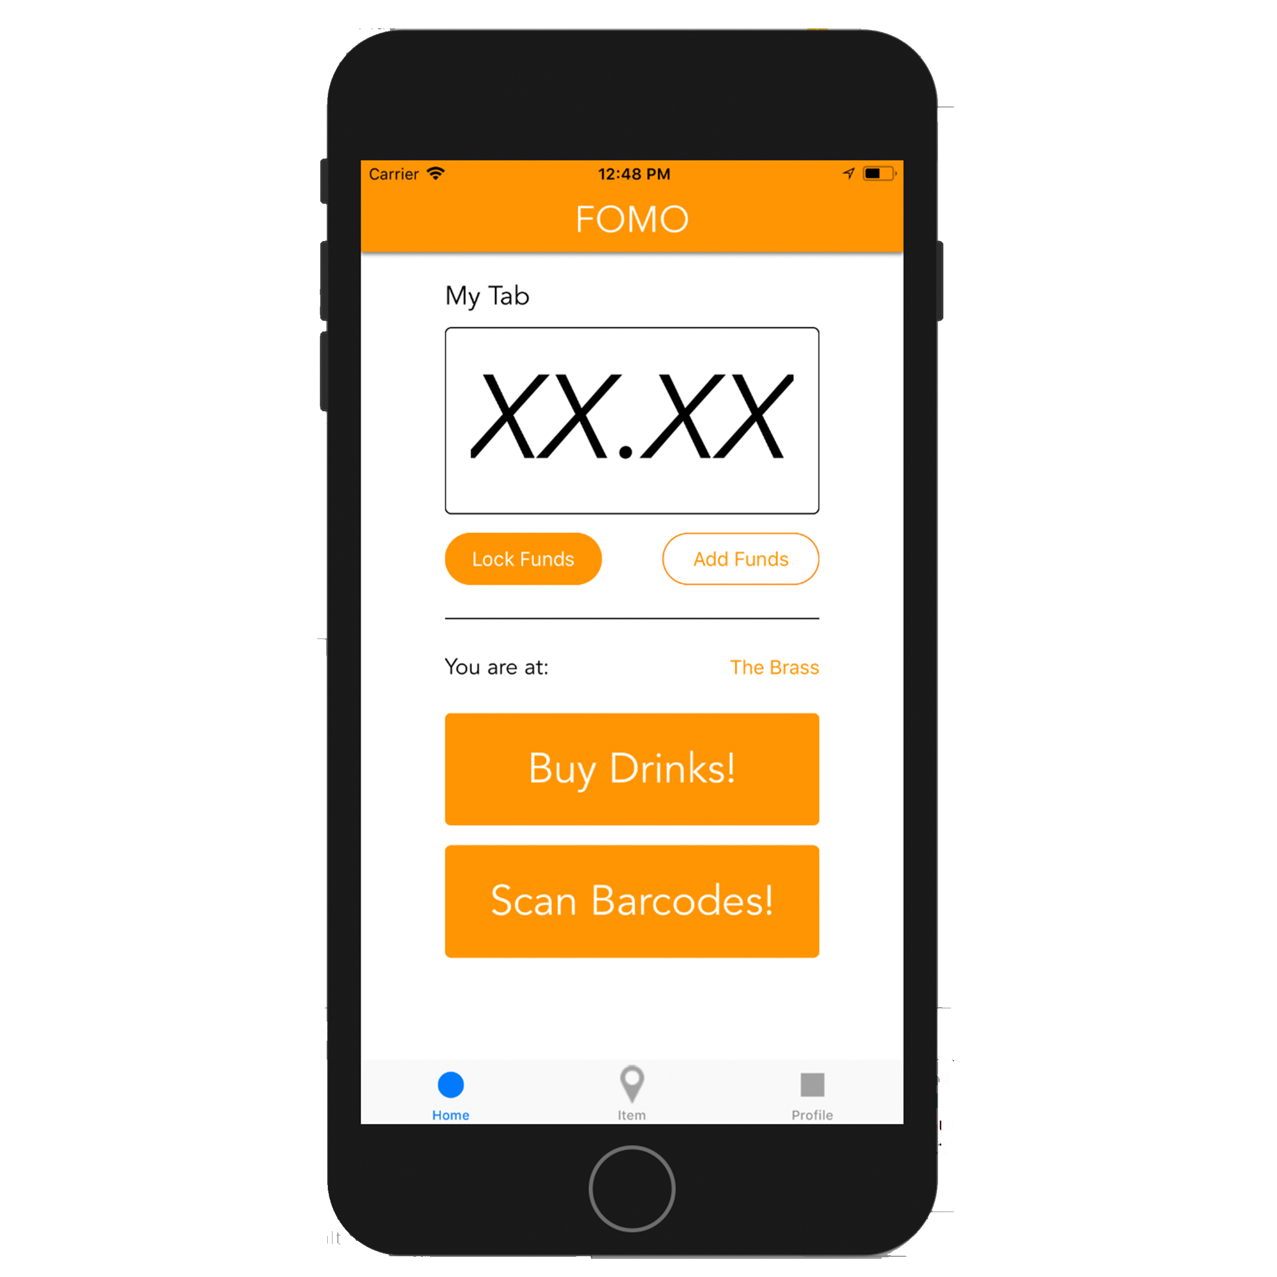
FOMO
SEAMLESS PAYMENTS AT THE BAR/CLUB
NO CASH OR CARD
SLOWER WAIT TIMES
SET LIMITS
TRACK PURCHASES
LOCATE BARS AROUND YOU

Slide 7
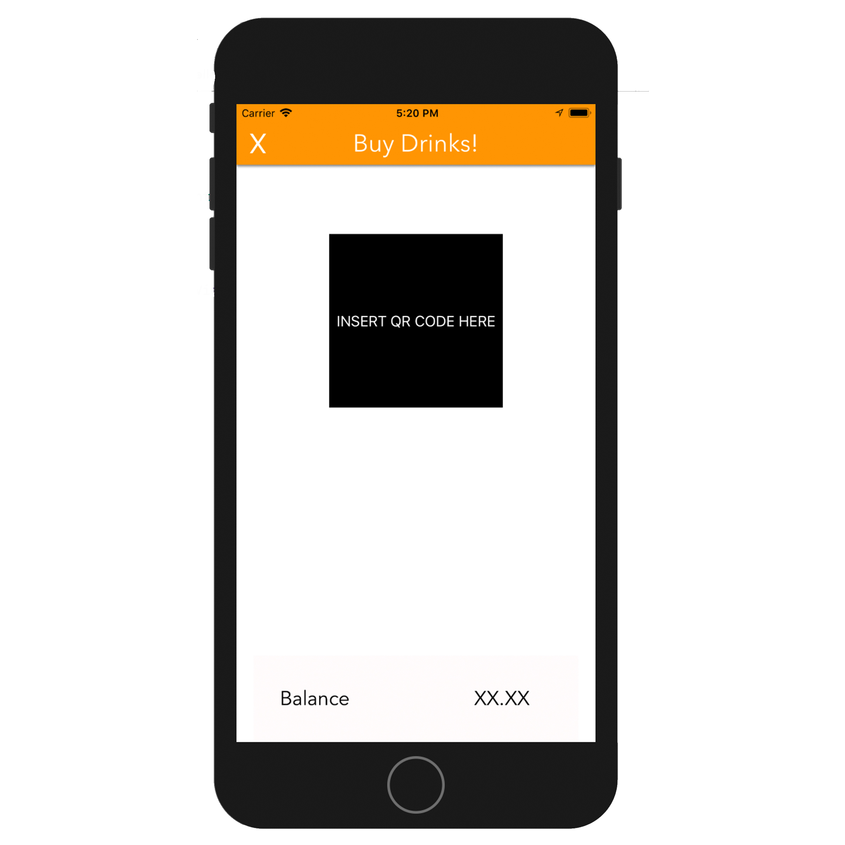
FOMO
SEAMLESS PAYMENTS AT THE BAR/CLUB
NO CASH OR CARD
SLOWER WAIT TIMES
SET LIMITS
TRACK PURCHASES
LOCATE BARS AROUND YOU

Slide 8
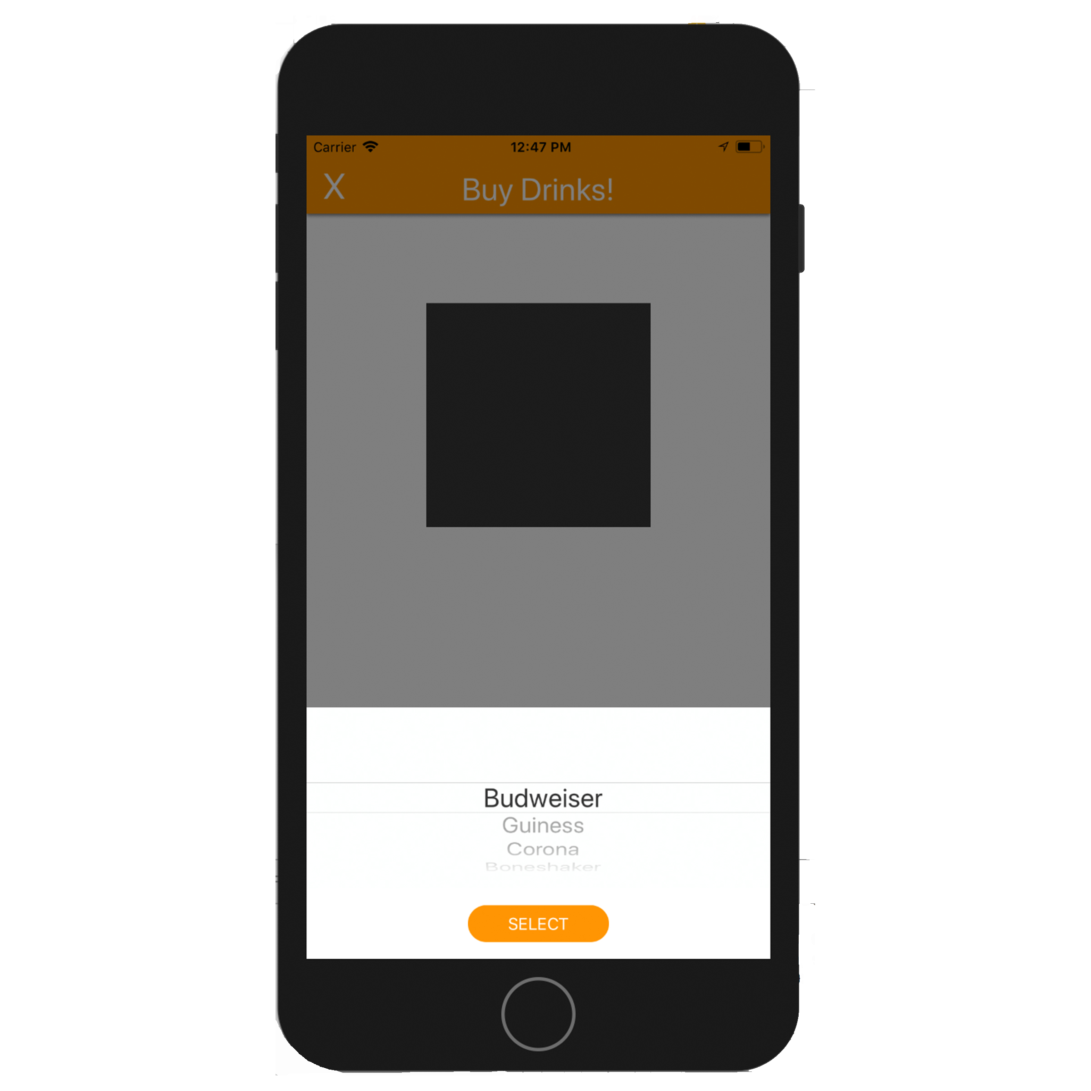
FOMO
SEAMLESS PAYMENTS AT THE BAR/CLUB
NO CASH OR CARD
SLOWER WAIT TIMES
SET LIMITS
TRACK PURCHASES
LOCATE BARS AROUND YOU

Slide 9
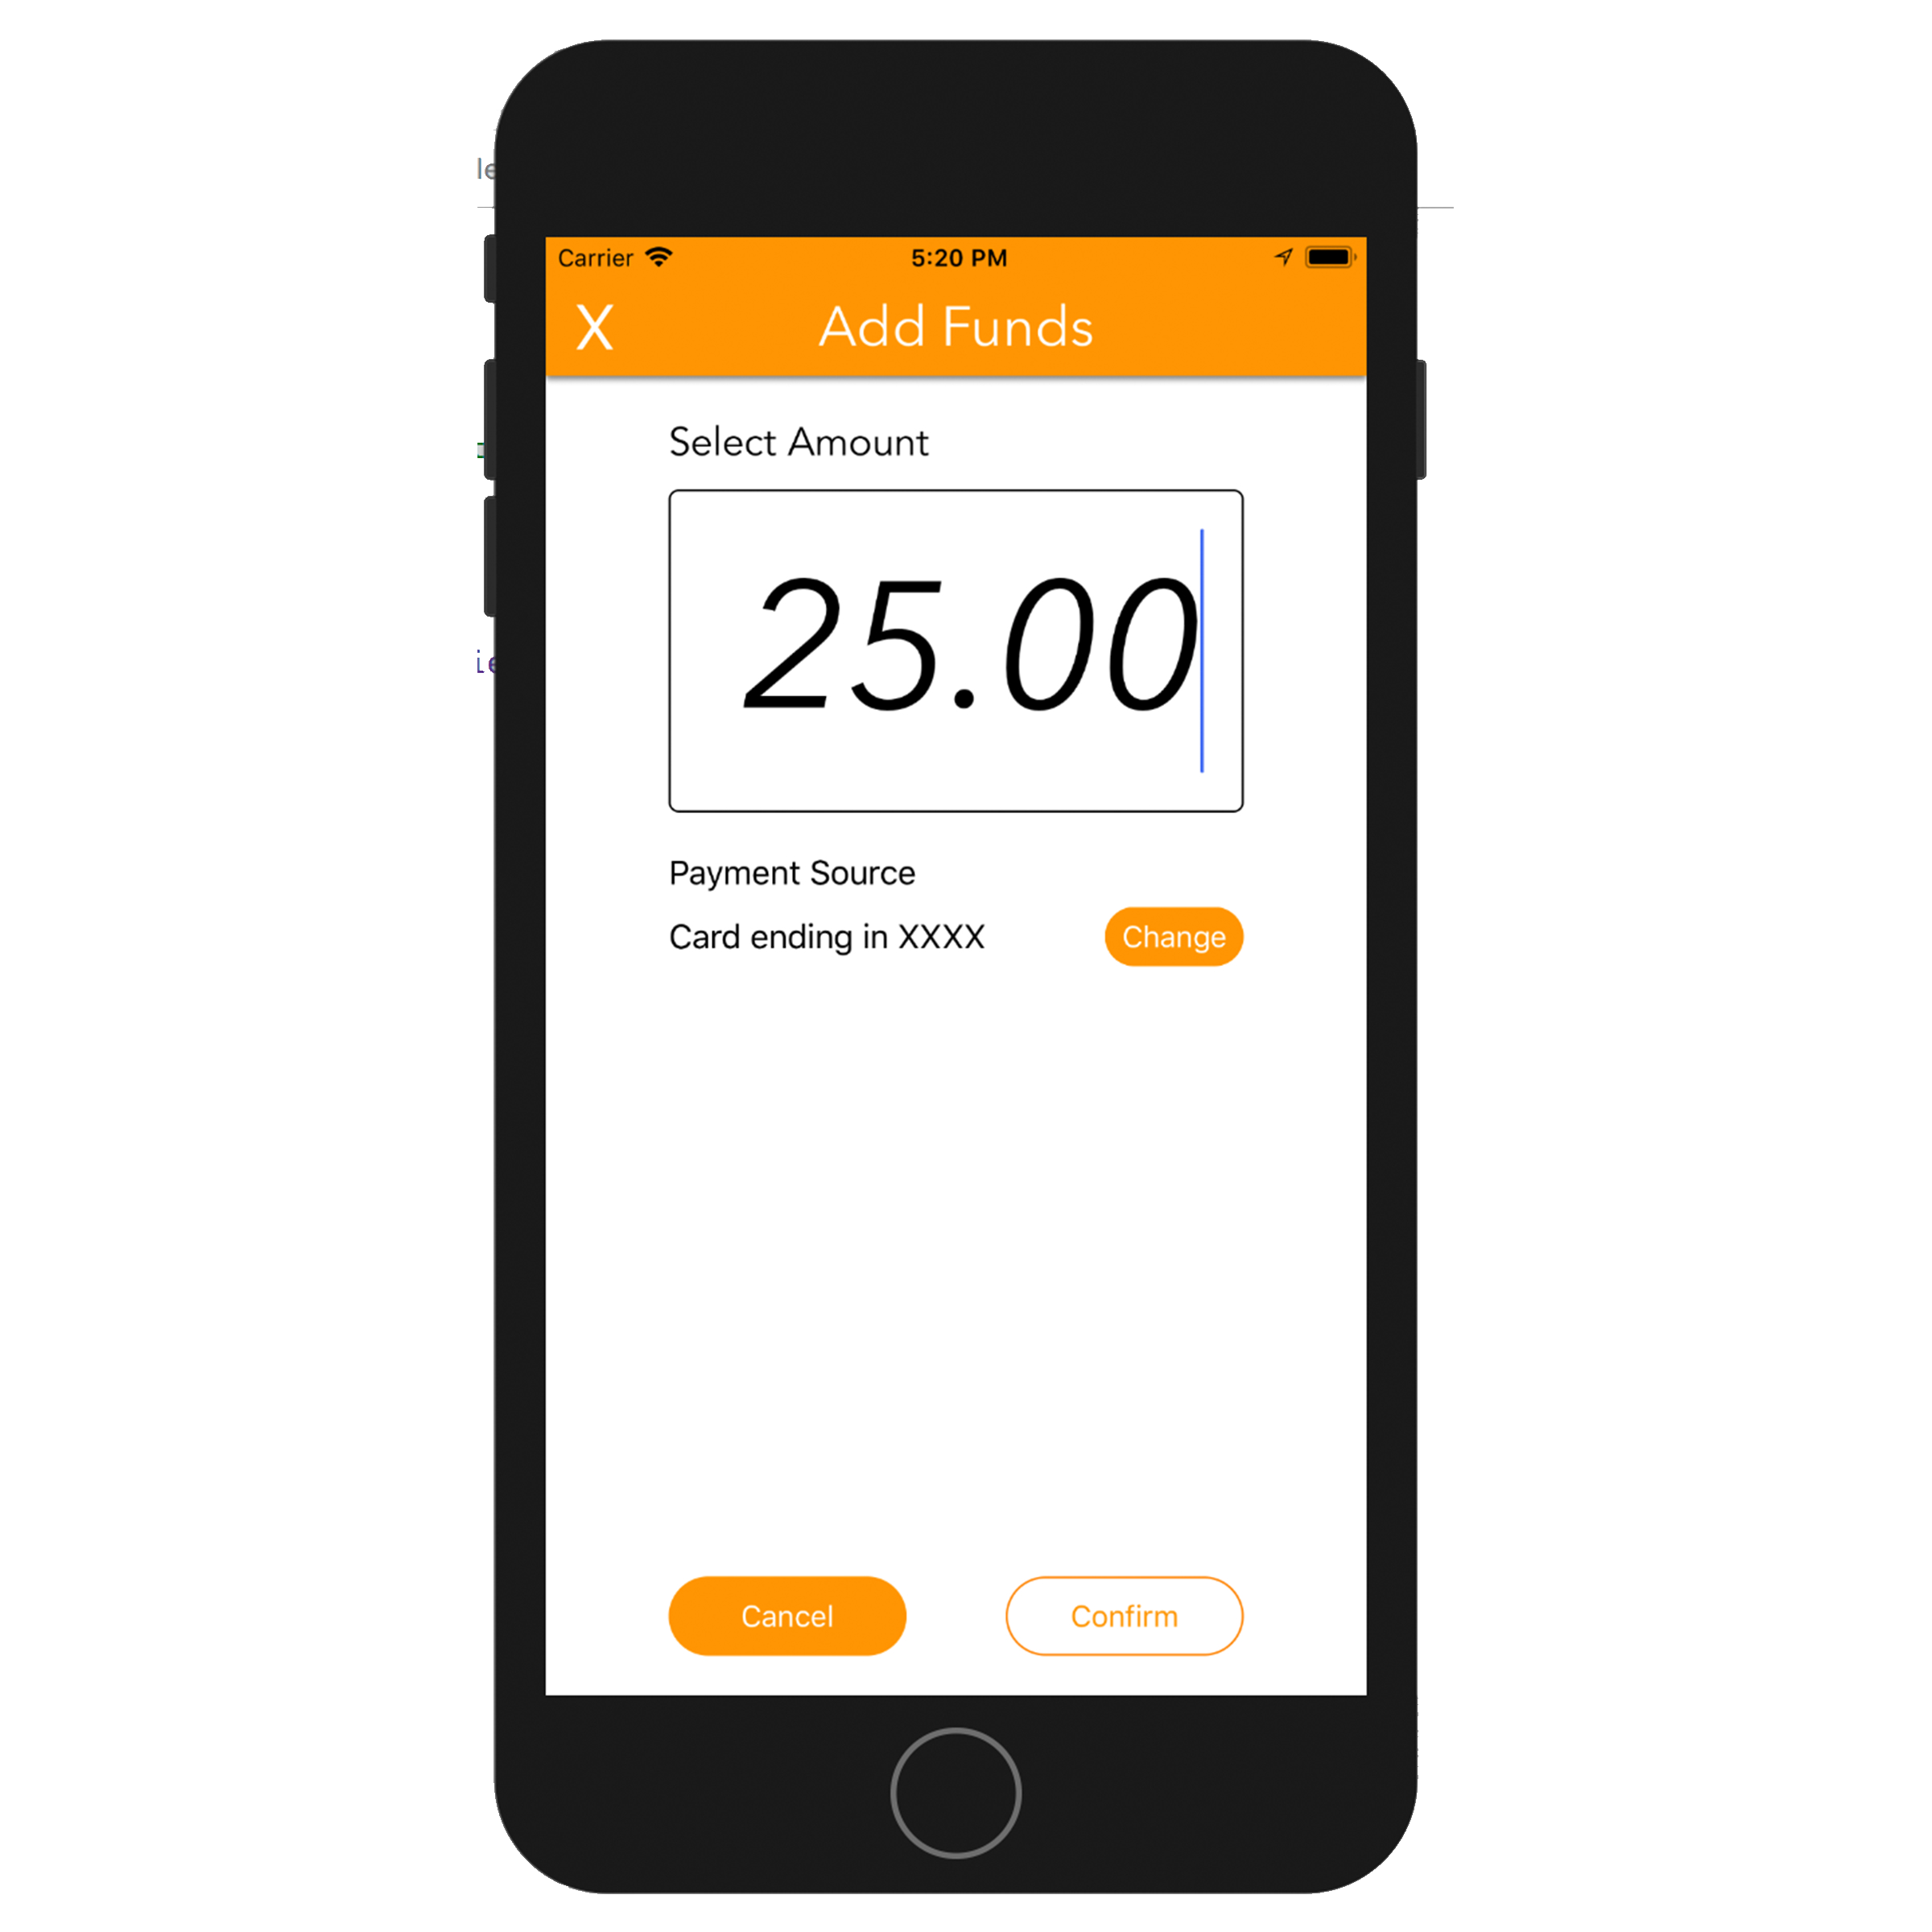
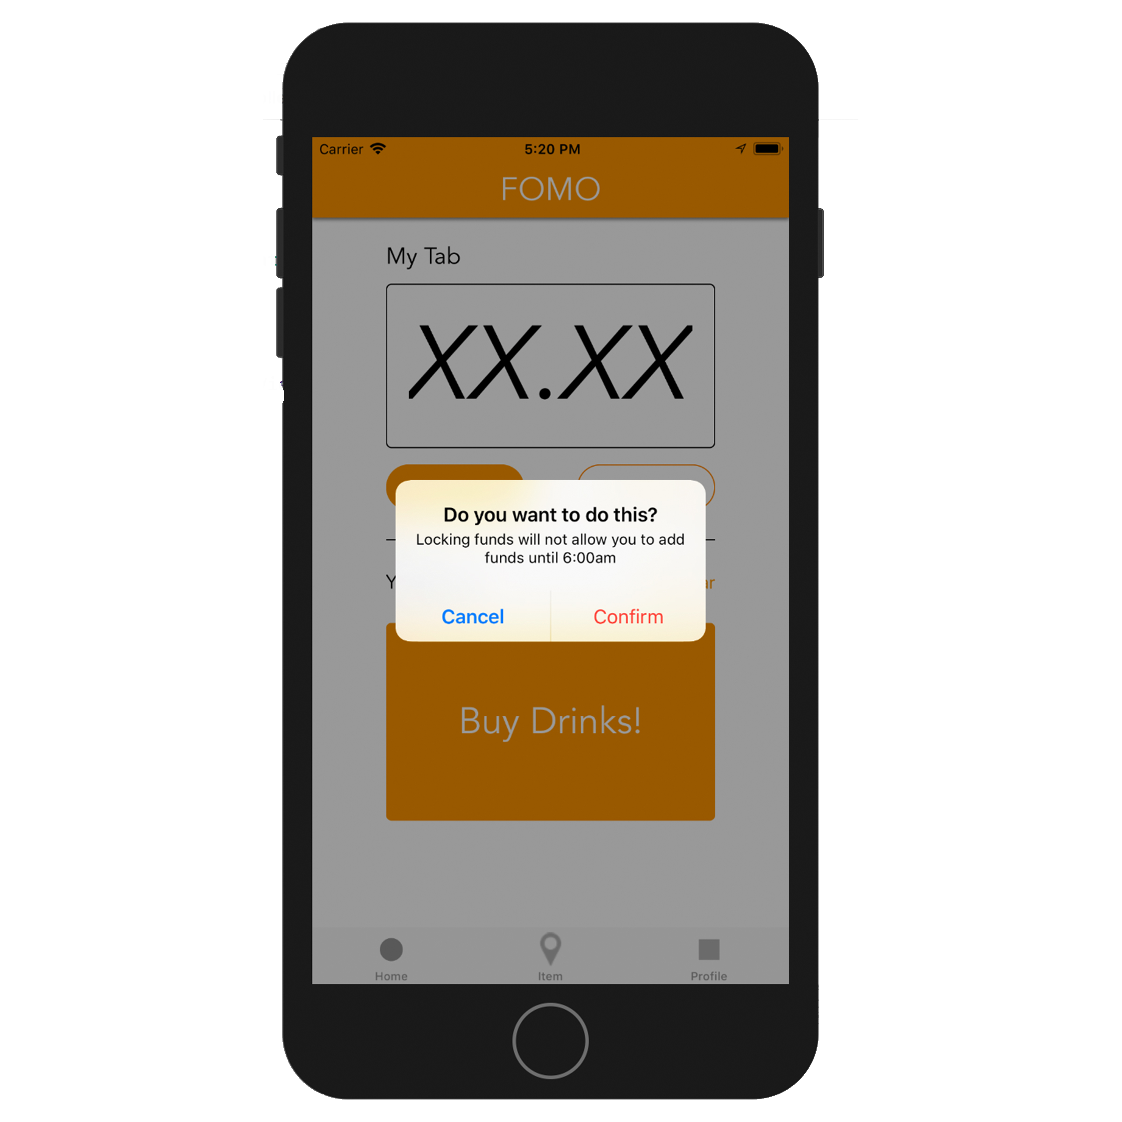
FOMO
SEAMLESS PAYMENTS AT THE BAR/CLUB
NO CASH OR CARD
SLOWER WAIT TIMES
SET LIMITS
TRACK PURCHASES
LOCATE BARS AROUND YOU

Slide 10
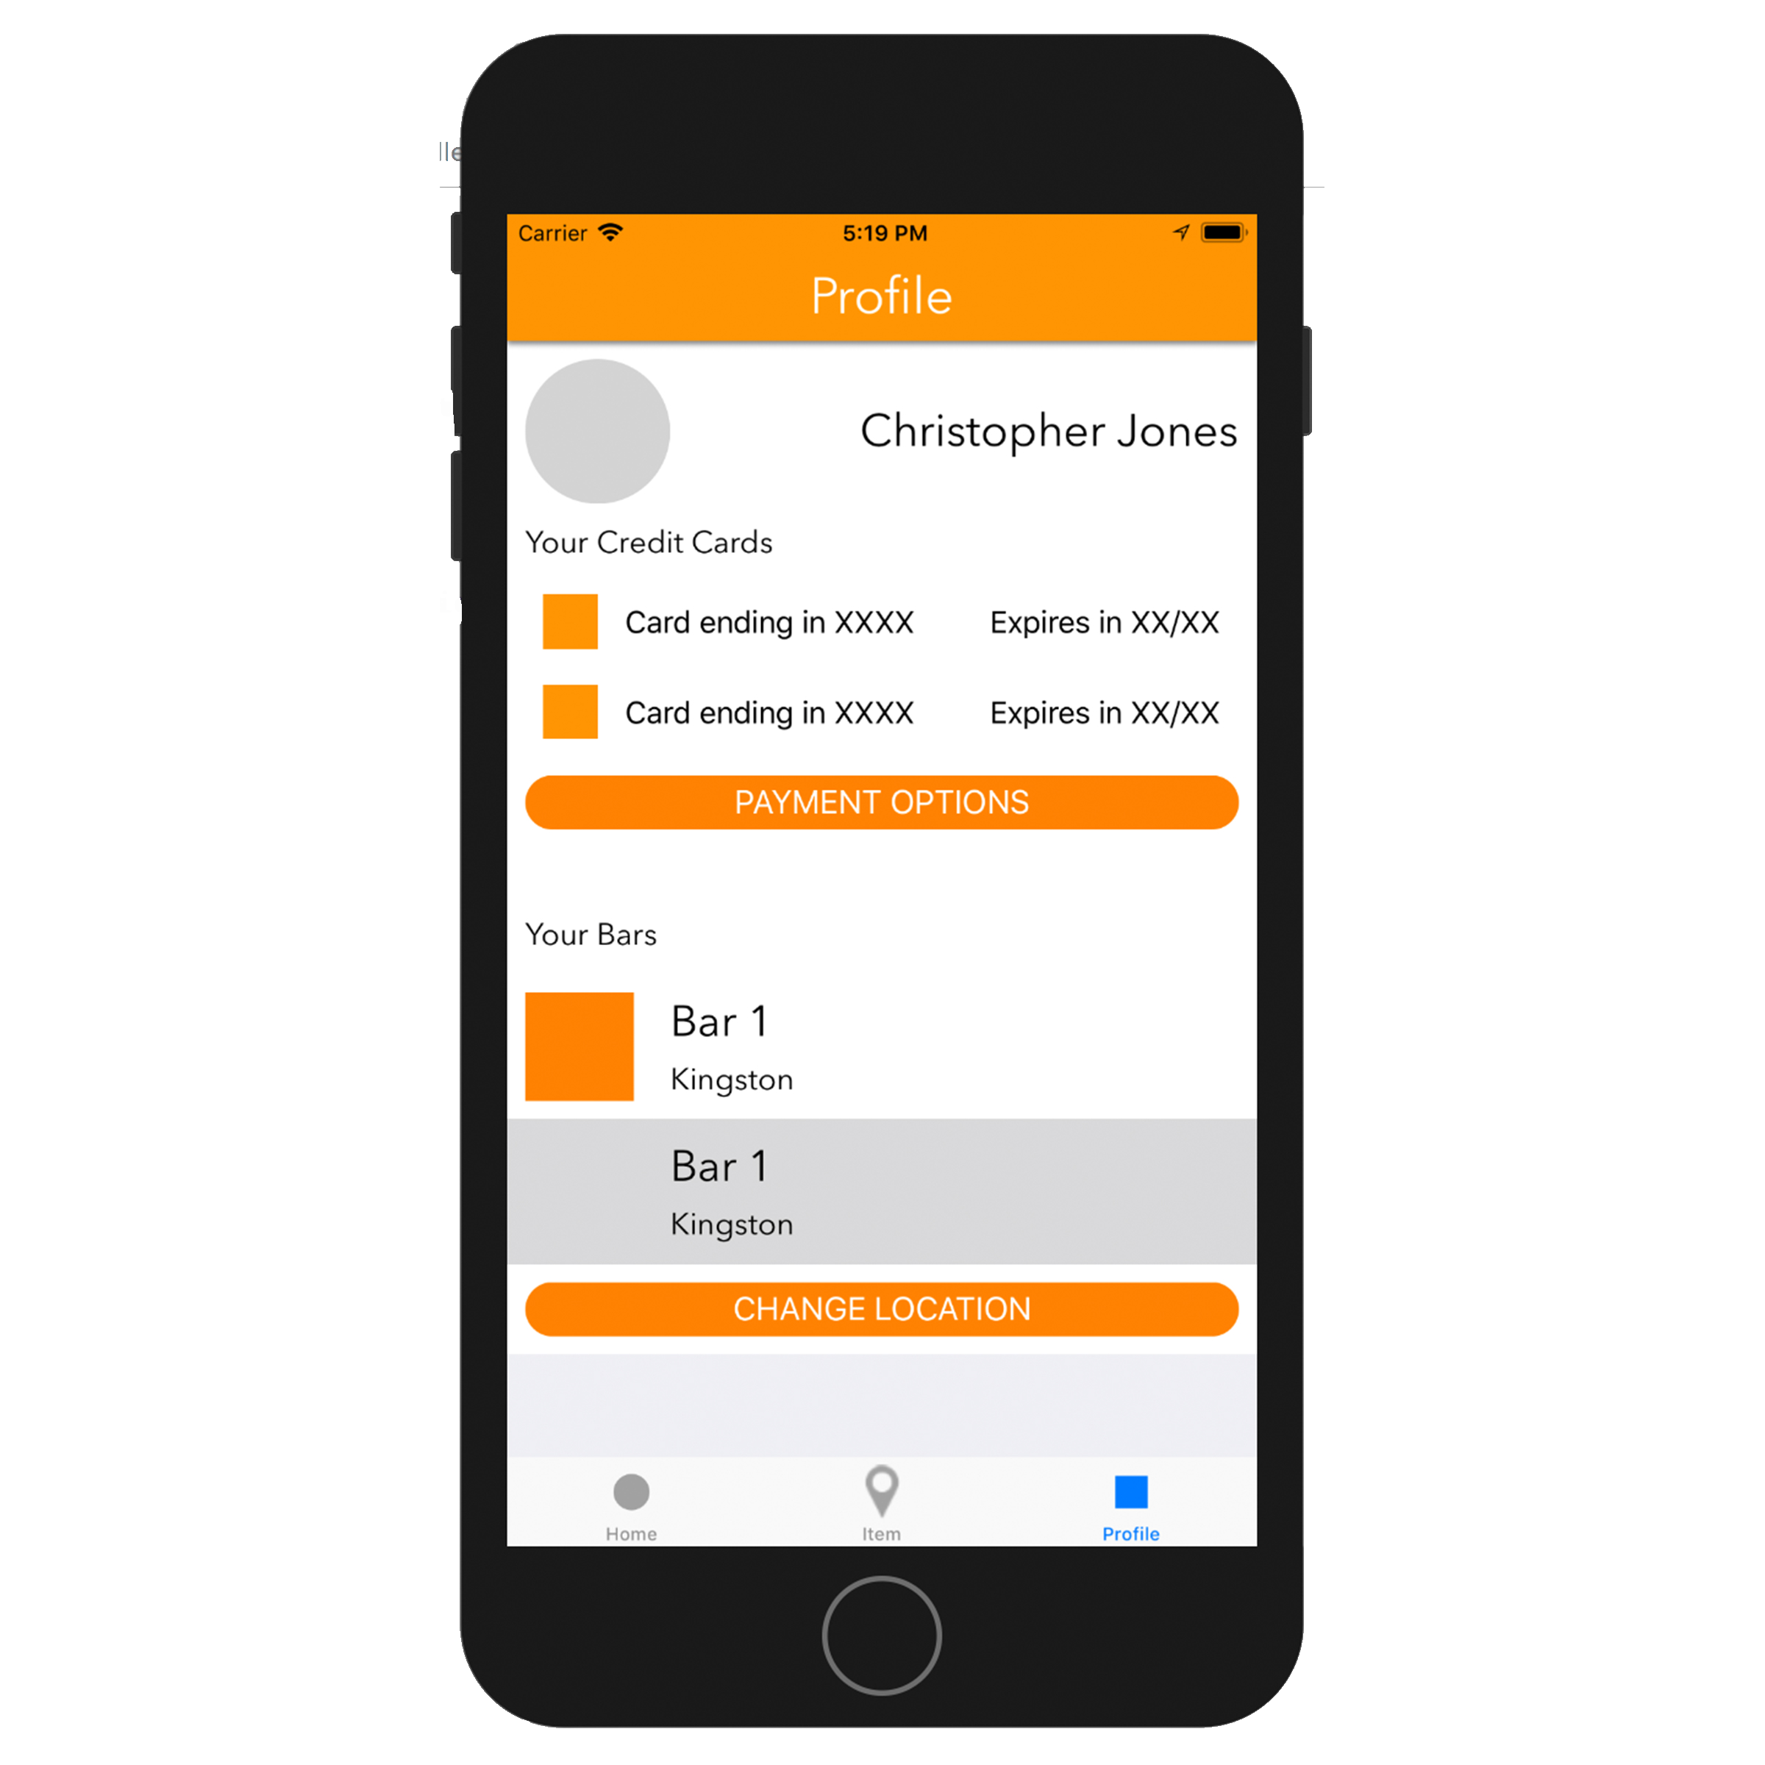
FOMO
SEAMLESS PAYMENTS AT THE BAR/CLUB
NO CASH OR CARD
SLOWER WAIT TIMES
SET LIMITS
TRACK PURCHASES
LOCATE BARS AROUND YOU

Slide 11
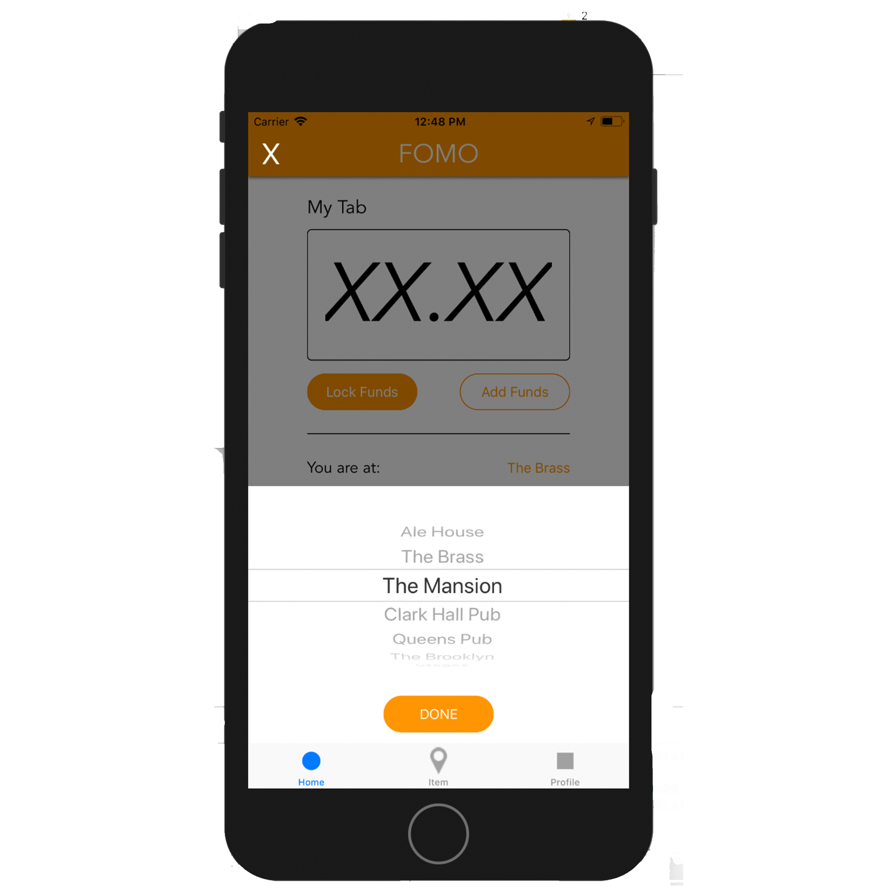
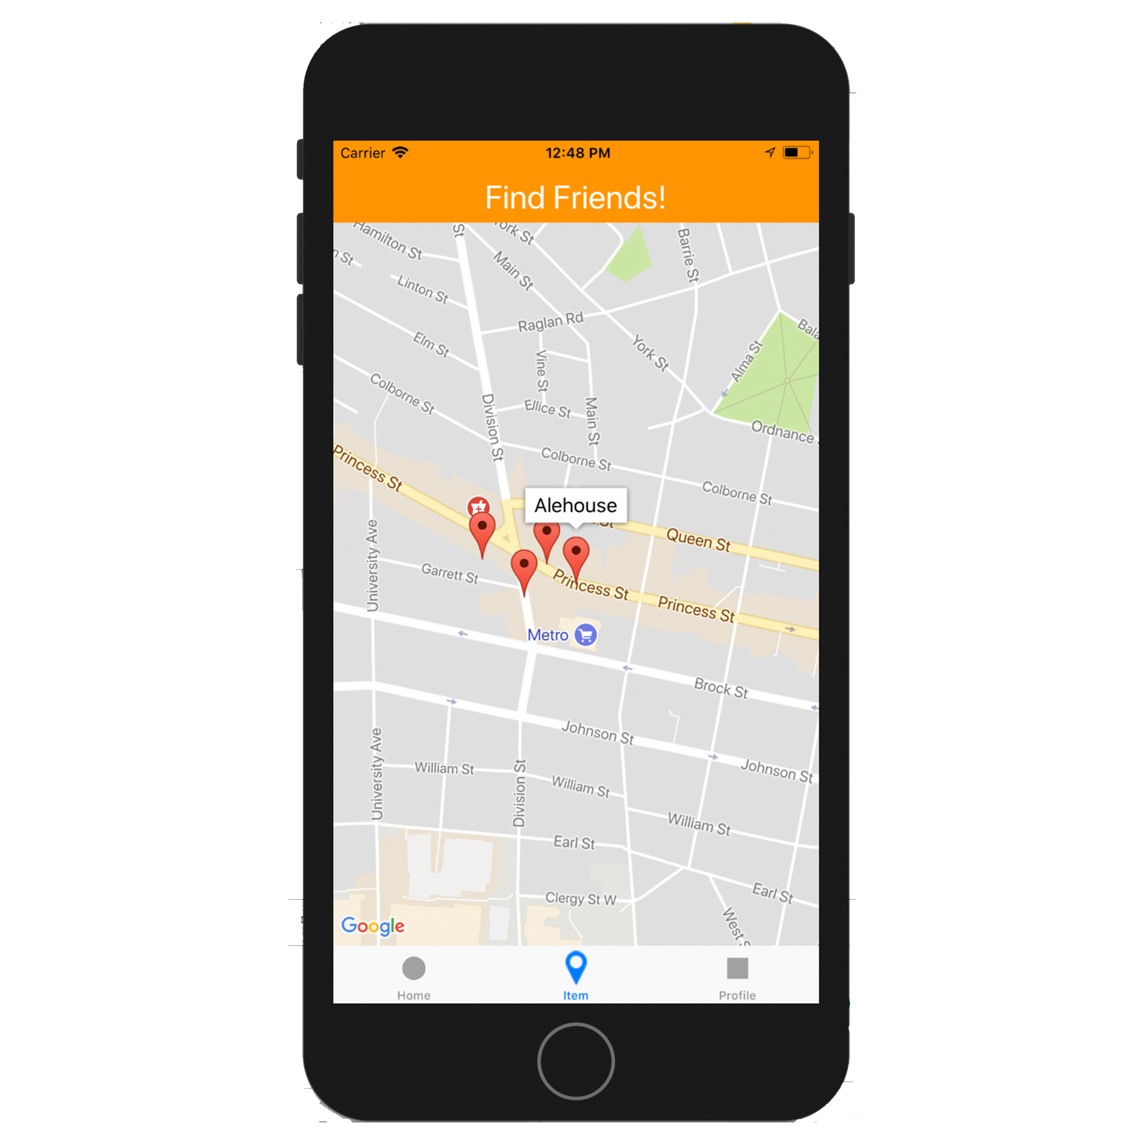
FOMO
SEAMLESS PAYMENTS AT THE BAR/CLUB
NO CASH OR CARD
SLOWER WAIT TIMES
SET LIMITS
TRACK PURCHASES
LOCATE BARS AROUND YOU

Slide 12
TEAM KAHSHE

Slide 13
FRONT END
Objective C
X-Code
User-friendly interface
Useable by both bartender and customer
Aesthetically Pleasing

Slide 14
BACK END
C++
MongoDB
Data stored and accessed through server
Personal accounts
Secure payment processing

Slide 15
Work Completion/Distribution
Back end
GUI
Presentation
Asthetics
Database Management
Mutual understanding of vision

Slide 16
Difficulties Faced
Overcome
Work division
X-Code problems
Starting Coding
Not-Overcome
Back/Front end integration
Communication (hipchat)

Slide 17
Work Left to Do
Integrate Database with Back/Front end
Communication with Front/Back end
Run accounts on server
Fill Database
Secure payment API’s

Slide 18
Good/Bad Library Use
Database Library (Libsson, MongoDB Driver)
Maps (Google Maps)
Payment API (PayPal)
QR Code Scanning (QR Code Reader View Controller)
QR Code Creating (QR Code Encoder)

Slide 19
Team Techniques
Worked
Openness
Splitting in to pairs
Brainstorming
Delegation of work
Failed
Pushing the team
Fair completion of work

Slide 20
What We Would Change
Interim Testing
Shorter, more frequent meetings
Start earlier
Narrow vision

Slide 21
NEVER MISS OUT AGAIN
Coming Soon
@FOMOAPP
Fomoapp.com
Kingsley Chu – Christopher Jones – Alistair Duff
David Garven – Rastislav Kovac – Roman Sokolovski

